Slide 1


CodeVR 1.0
Team Members: Andres Chalela, Rolf Gilet, Miguel Jardines Product Owner: Dr. Francisco Ortega
Instructor: Dr. Francisco Ortega, Dr. Masoud Sadjadi School of Computing and Information Sciences Florida International University
Final Presentation
Spring 2018
Notes:
7 seconds.( I will select 2 best slides (i will give them extra points and students will present for CIS committee)
Greet your audience, thank them for attending your presentation, introduce yourself, introduce your project, introduce your team members, and quickly indicate what each of you did in a high-level manner, and put more emphasis on your part/contribution.

Slide 2
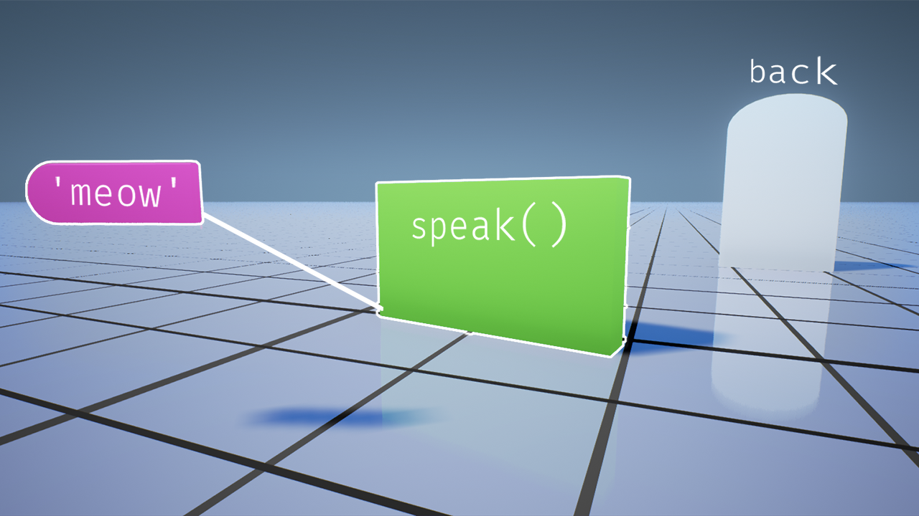
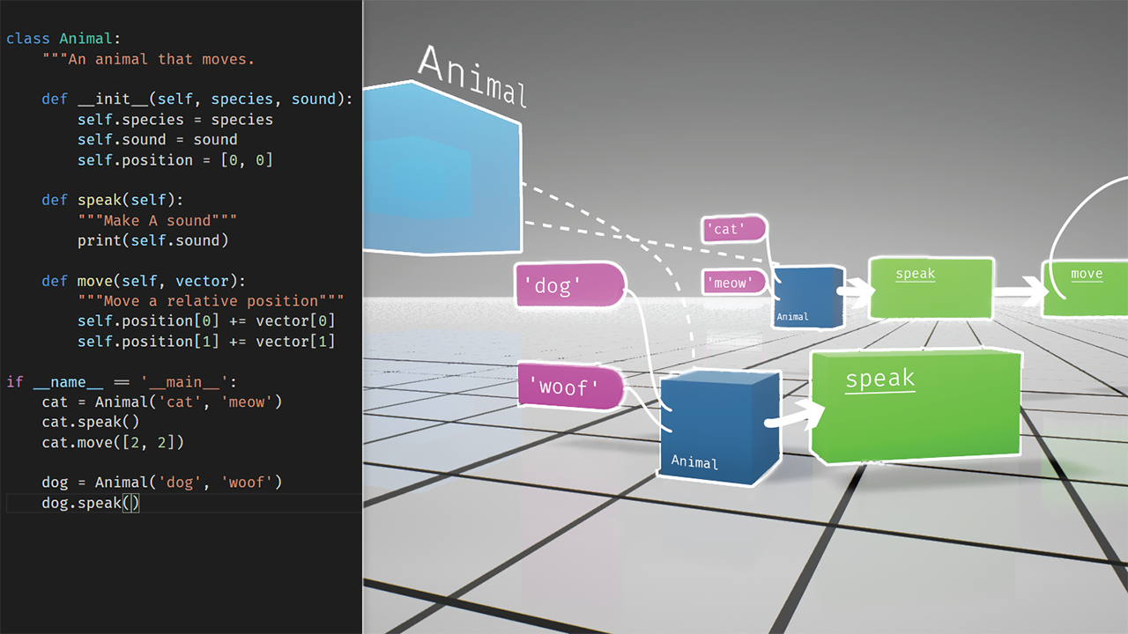
FIU OpenHID Lab: CodeVR
Blocks-Based Interactive
VR Programming
Notes:
10 seconds.
Introduce the problem that the whole project (in all versions) tackles with GIF or screenshot.

Slide 3
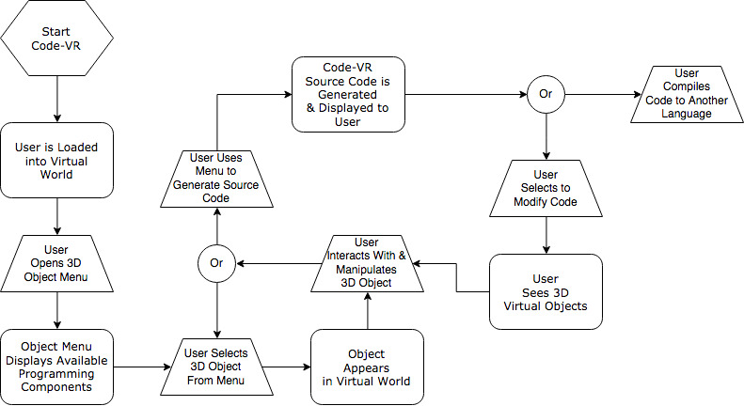
CodeVR 1.0
Flow Chart of CodeVR 1.0
Application
Notes:
20 seconds.
Introduce the problem that the your project (in new version) tackles with GIF or screenshot.

Slide 4
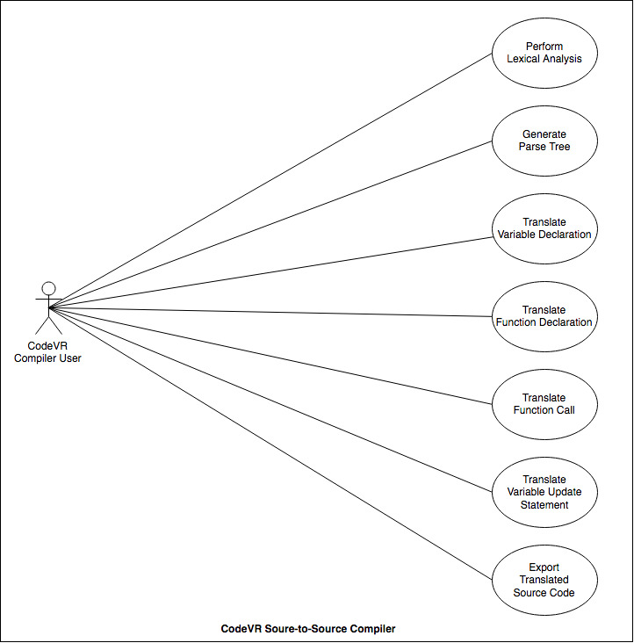
Requirements: Use Cases
CodeVR Source-to-Source Compiler Use Cases
Notes:
5 seconds
Show the Use Case Diagram for the whole project. Highlight your use cases.

Slide 5
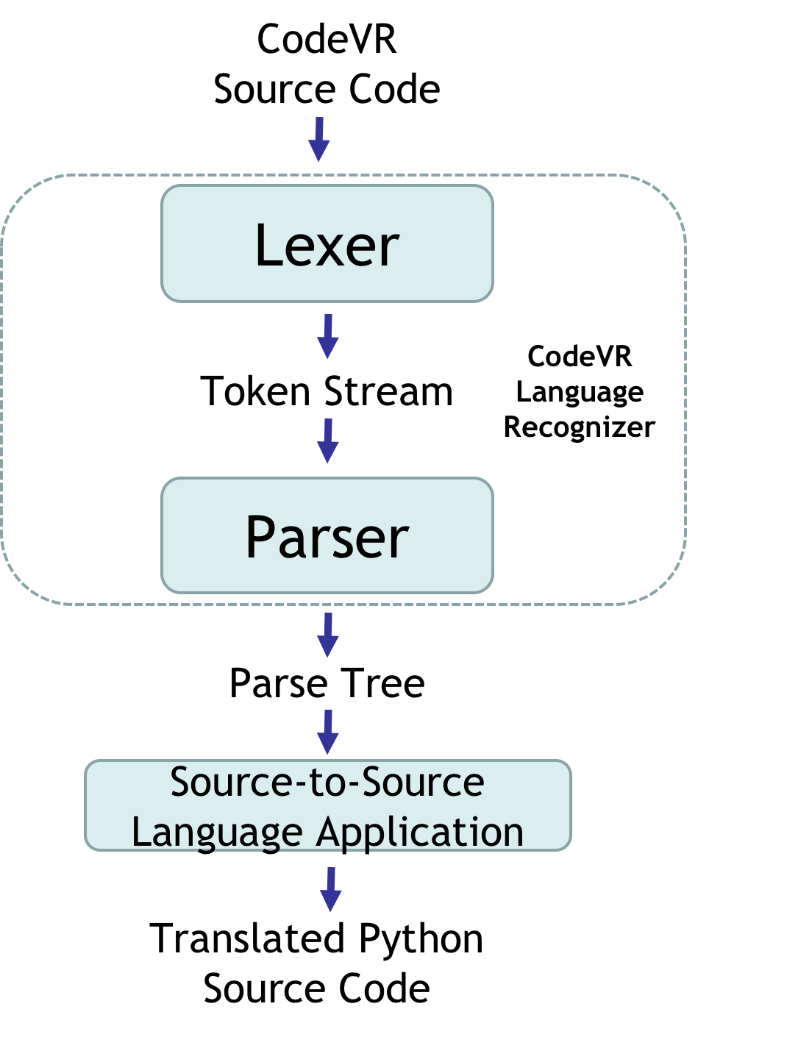
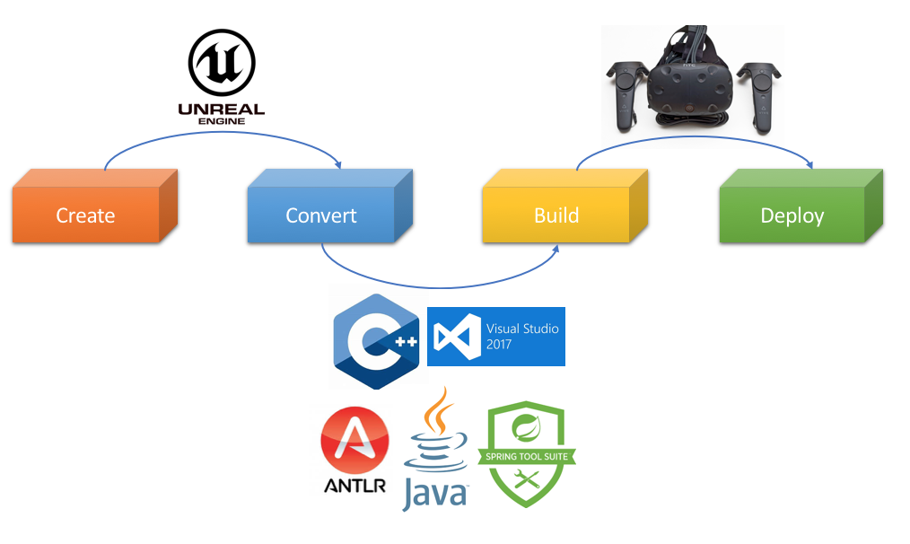
System Design: Architecture
CodeVR 1.0 Deployment Diagram
CodeVR
Source to Source Compiler
Notes:
20 seconds
System design: Highlight the parts that you contributed to them.
1. System decomposition; identify the architecture patterns used
2. System deployment – h/w and s/w requirements

Slide 6
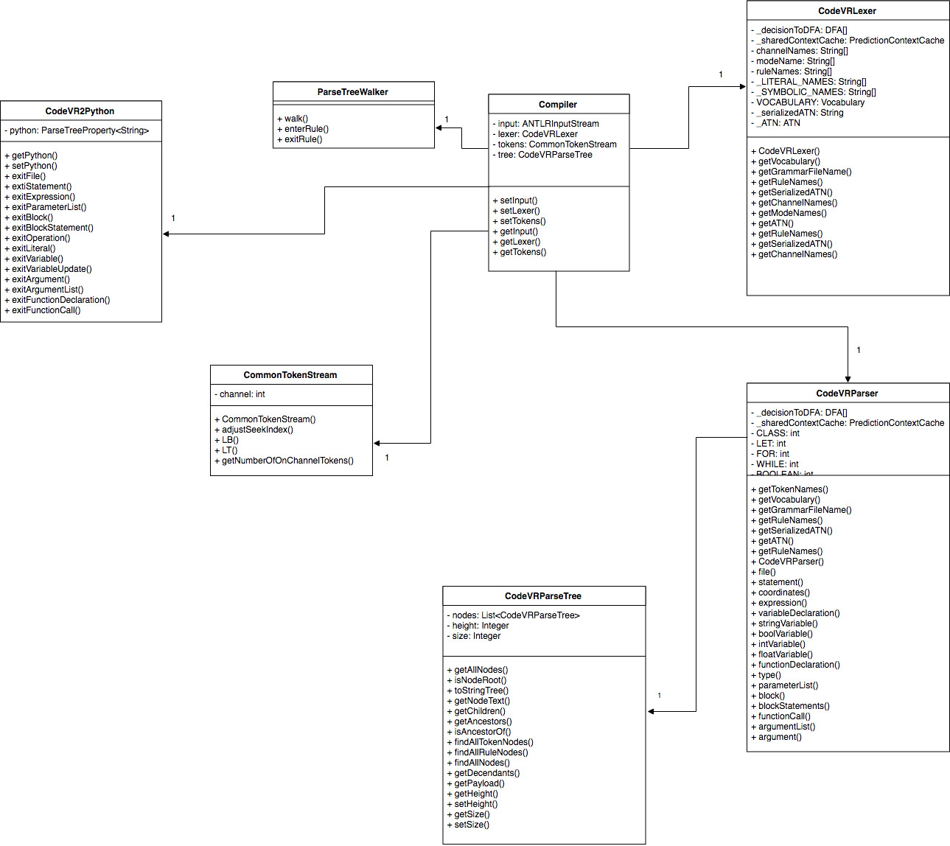
Minimal Class Diagram
Notes:
10 seconds.Minimal class diagram. Highlight the classes that you created/modified
Identify the design patterns used (one or more slides).

Slide 7
User Stories
User Story #744 CodeVR Language Application (Phase 2)
User Story #724 CodeVR Language Application (Phase 1)
User Story #710 CodeVR Compiler Implementation (Parser Phase)
User Story #704 CodeVR Compiler Implementation (Lexer Phase)
User Story#670 Complete Parser Implementation
Notes:
5 seconds.
List the user stories that you worked on them.(put in order of importance). Stay focused on the parts that you have been working.

Slide 8
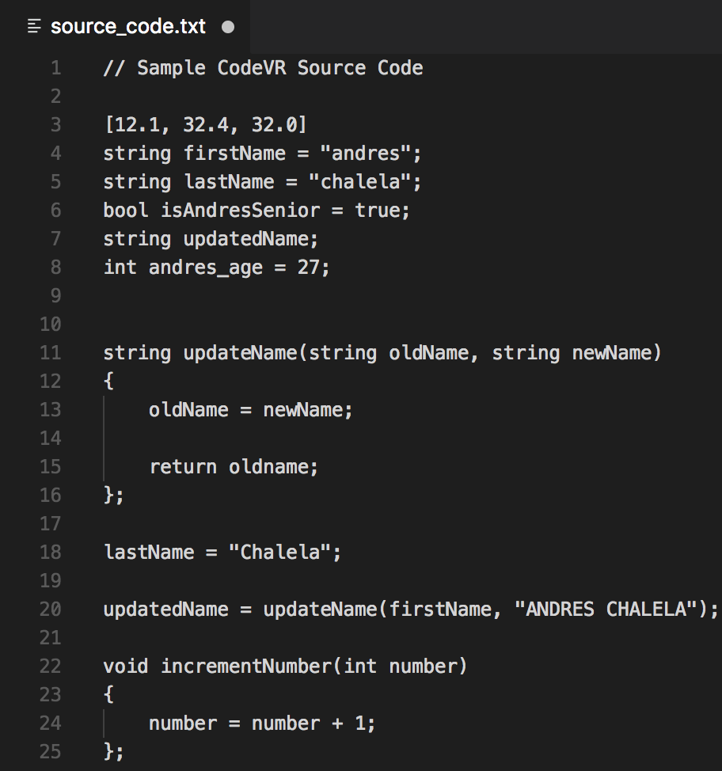
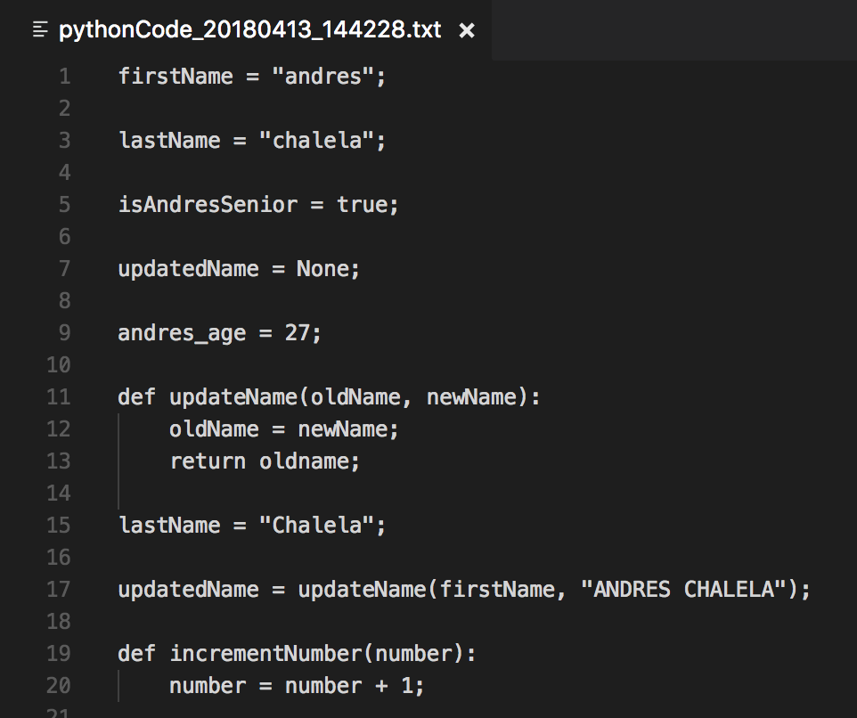
User Story #1:
CodeVR Language Application (Phase 2)
“As a developer, I have to implement a source to source CodeVR language application, so that the exported CodeVR language source code can be translated into Python source code.”
Translated Python Source Code
CodeVR Source Code
Notes:
60 seconds
The tile of user story
The most important user story you worked on it. You have to describe this one very well and be proud of that.
Please present and show the complexity of your work, code, algorithms, and technical challenges and technologies you have used. (you could use screenshot if you want. Visual presentations are better than text presentation)
Go into the details of the most important/significant tasks using bullet lists or visual graphs or state chart diagram
Sequence Diagram for this user story is mandatory (in another separate page if required)
Demo using screenshots or GIF (in another separate page if required)

Slide 9
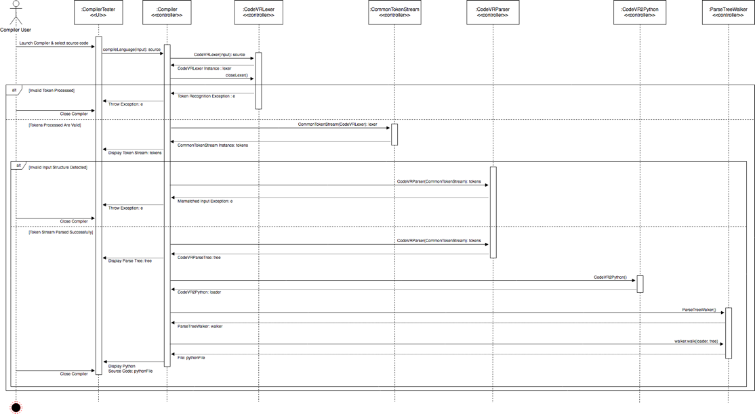
User Story #1: Sequence Diagram
Execution of CodeVR Source-to-Source Compiler
Notes:
60 seconds
The tile of user story
The most important user story you worked on it. You have to describe this one very well and be proud of that.
Please present and show the complexity of your work, code, algorithms, and technical challenges and technologies you have used. (you could use screenshot if you want. Visual presentations are better than text presentation)
Go into the details of the most important/significant tasks using bullet lists or visual graphs or state chart diagram
Sequence Diagram for this user story is mandatory (in another separate page if required)
Demo using screenshots or GIF (in another separate page if required)

Slide 10
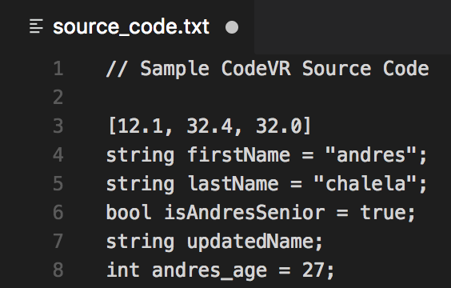
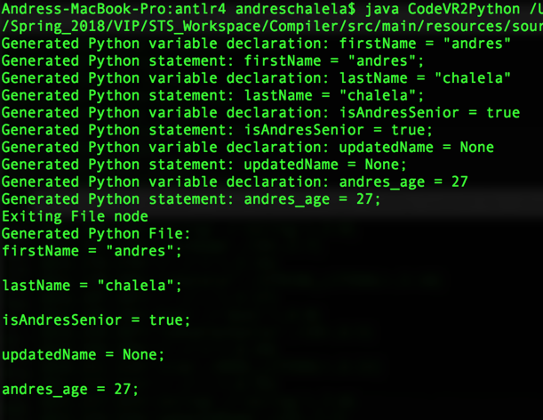
User Story #2:
CodeVR Language Application (Phase 1)
“As a developer, I have to implement a source to source CodeVR language application, so that the exported CodeVR language source code can be translated into Python source code.”
CodeVR Source Code
CodeVR Compiler Console Output
Notes:
20 seconds
The tile of user story
Please present and show the complexity of your work, code, algorithms, and technical challenges and technologies you have used. (you could use screenshot if you want. Visual presentations are better than text presentation) - Go into the details of the most important/significant tasks using bullet lists or visual graphs or state chart diagram - Demo using screenshots or GIF (in another separate page if required)
Sequence Diagram for this user story is optional

Slide 11
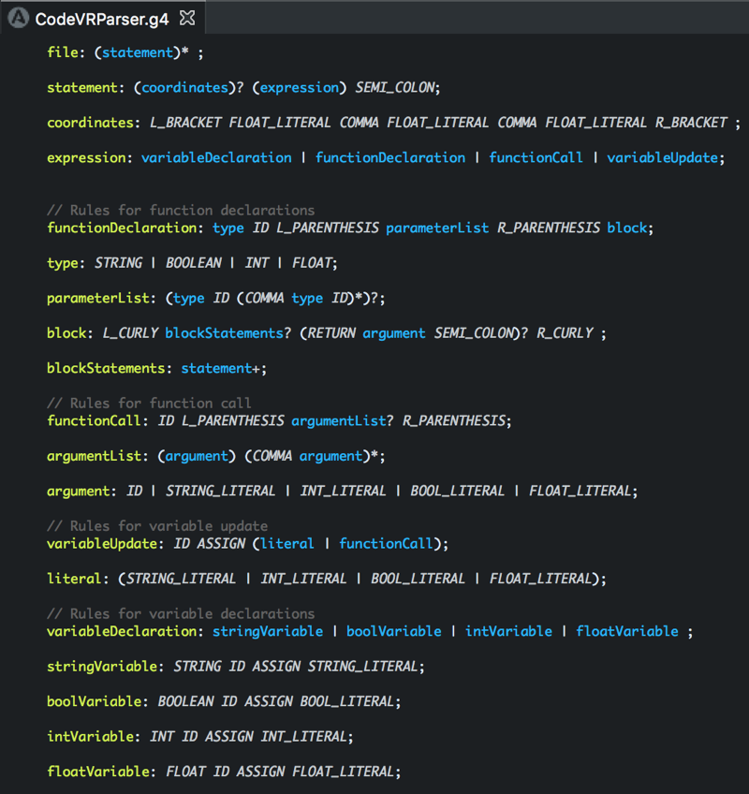
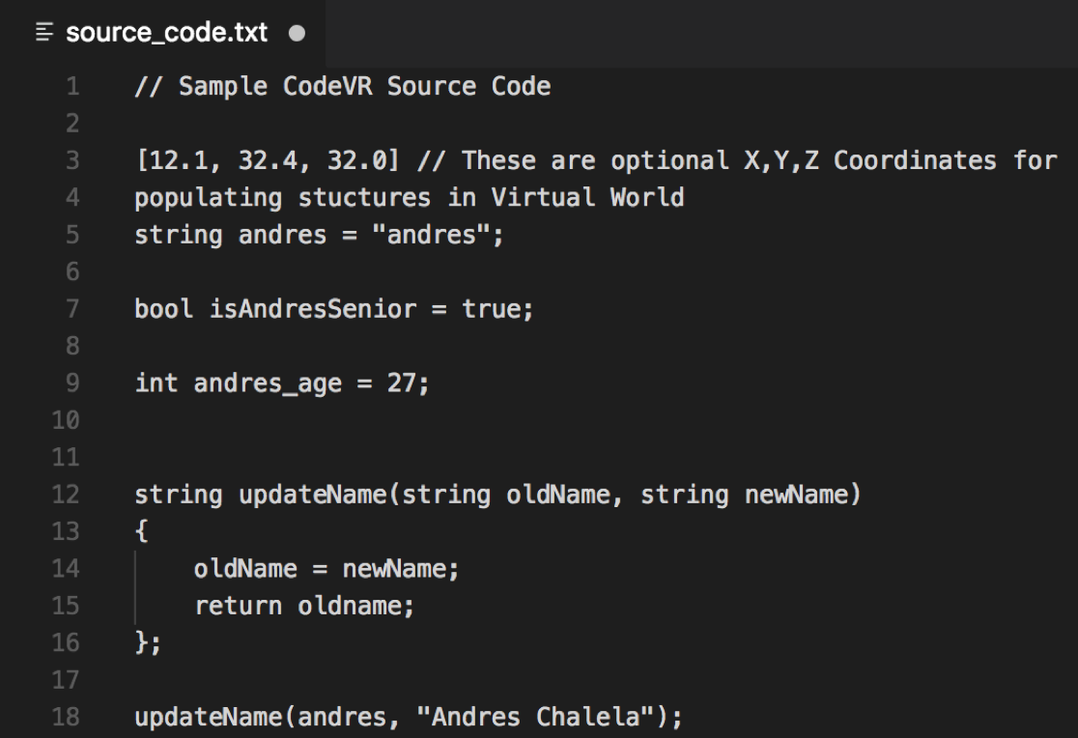
User Story #3:
CodeVR Compiler Implementation
(Parser Phase)
“As a developer, I have to implement the Parser module of the CodeVR compiler, so that an abstract syntax tree can be generated for our language application.”
CodeVR Source Code
CodeVR Language Parser Grammar Rules
Notes:
20 seconds
The tile of user story
Please present and show the complexity of your work, code, algorithms, and technical challenges and technologies you have used. (you could use screenshot if you want. Visual presentations are better than text presentation) - Go into the details of the most important/significant tasks using bullet lists or visual graphs or state chart diagram - Demo using screenshots or GIF (in another separate page if required)
Sequence Diagram for this user story is optional

Slide 12
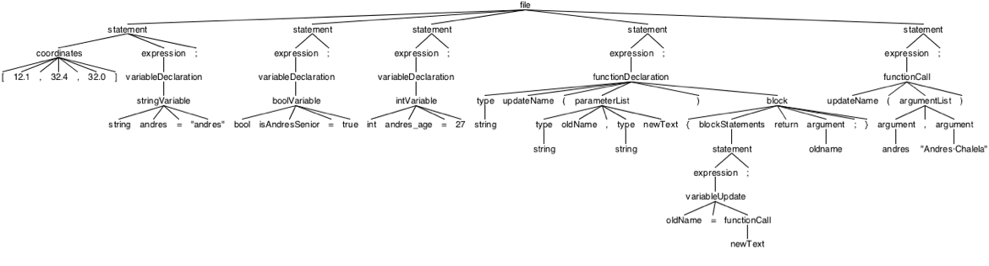
CodeVR Sample Parse Tree
Generated CodeVR Parse Tree
Notes:
20 seconds
The tile of user story
Please present and show the complexity of your work, code, algorithms, and technical challenges and technologies you have used. (you could use screenshot if you want. Visual presentations are better than text presentation) - Go into the details of the most important/significant tasks using bullet lists or visual graphs or state chart diagram - Demo using screenshots or GIF (in another separate page if required)
Sequence Diagram for this user story is optional

Slide 13
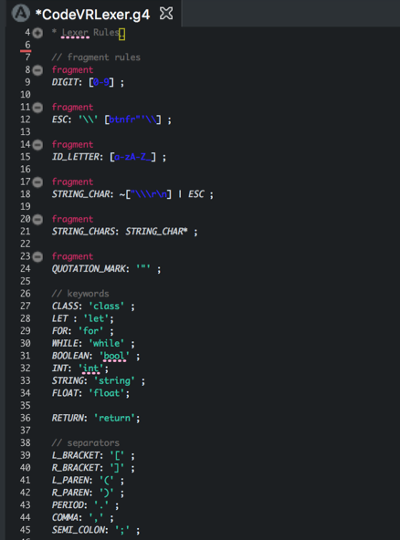
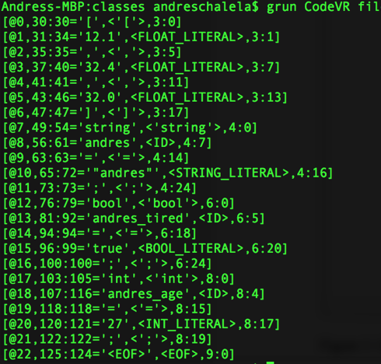
User Story #4:
CodeVR Compiler Implementation
(Lexer Phase)
“As a developer, I have to implement the Lexer module of the CodeVR compiler, so that the CodeVR language source code can be tokenized into a character stream for the Parser module.”
CodeVR Lexical Analysis Output
CodeVR Language Lexer Rules
Notes:
20 seconds
The tile of user story
Please present and show the complexity of your work, code, algorithms, and technical challenges and technologies you have used. (you could use screenshot if you want. Visual presentations are better than text presentation) - Go into the details of the most important/significant tasks using bullet lists or visual graphs or state chart diagram - Demo using screenshots or GIF (in another separate page if required)
Sequence Diagram for this user story is optional

Slide 14
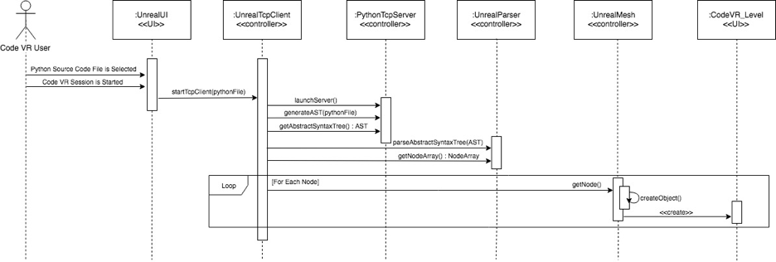
User Story #5:
Complete Parser Implementation
“As a developer, I need to complete the implementation of the JSON parser, so that we’re able to completely display the different types of programming elements/objects in VR.”
JSON Parser Execution & 3D Object Generation
Notes:
20 seconds
The tile of user story
Please present and show the complexity of your work, code, algorithms, and technical challenges and technologies you have used. (you could use screenshot if you want. Visual presentations are better than text presentation) - Go into the details of the most important/significant tasks using bullet lists or visual graphs or state chart diagram - Demo using screenshots or GIF (in another separate page if required)
Sequence Diagram for this user story is optional

Slide 15
CodeVR Compiler Testing
Manual Testing for all Use Cases
Lexical Analysis
Parser Rules & Tree Generation
Tree Traverals & Code Translations
Export of Generated Source Code
Notes:
10 seconds
A description of verification process and Test Suites and Test Cases for one of the use cases.
1 One sunny day and one rainy day for the implemented use cases (one or more slides).
2 Automated test scripts for the implemented use cases (if any) (one or more slides).

Slide 16








Summary
Andres Chalela achal012@fiu.edu
Thank You!
Notes:
10 seconds
Summarize your contribution, mention your effort for Scrum, Mingle, Github, Google Drive Documentation and minutes
Include your contact information
Ask if anyone has any questions for you.
Thank your audience

